Slide 1
Nondeterministic programming

Slide 2
Nondeterminism
Nondeterminism is a blanket term for programs that can potentially
Do different things
On different runs with the same input
Means different things in different contexts
Randomized algorithms
Algorithms that makes some choices randomly (e.g. randomized quicksort)
Nondeterminism is good here
Parallel programs
Where the sequence of events depends on the relative speed of the different threads
Nondeterminism is bad here

Slide 3
Angelic nondeterminism
A specific kind of “good” nondeterminism
Program is non-deterministic: it permits different execution paths
But we assume it only runs “good” execution paths
Then you can write underspecified programs
And trust they’ll always do the right thing
This gives you a new programming paradigm: (deliberately) nondeterministic programming
There are a number of nondeterministic programming languages that behave this way

Slide 4
Deterministic algorithms
Normal algorithms specify exactly what to do at each point in time
Deterministic sequences
Do this
Then do that
Deterministic choices
Do this if something is true
Otherwise do that
You’ve gotten very good at writing these by now

Slide 5
Deterministic choices don’t work with delayed feedback
What if you don’t have enough information to make the choice now?
What if you can’t know whether it was the right choice until after you make it?
Then you have to guess
And try again if you guessed wrong

Slide 6

Example: parsing
Given the grammar
$S→NP IV$
$S→NP TV NP$
$S→NP DV NP NP$
$NP→Pronoun$
$NP→Det N$
Write a parser that parses English using these rules

Slide 7
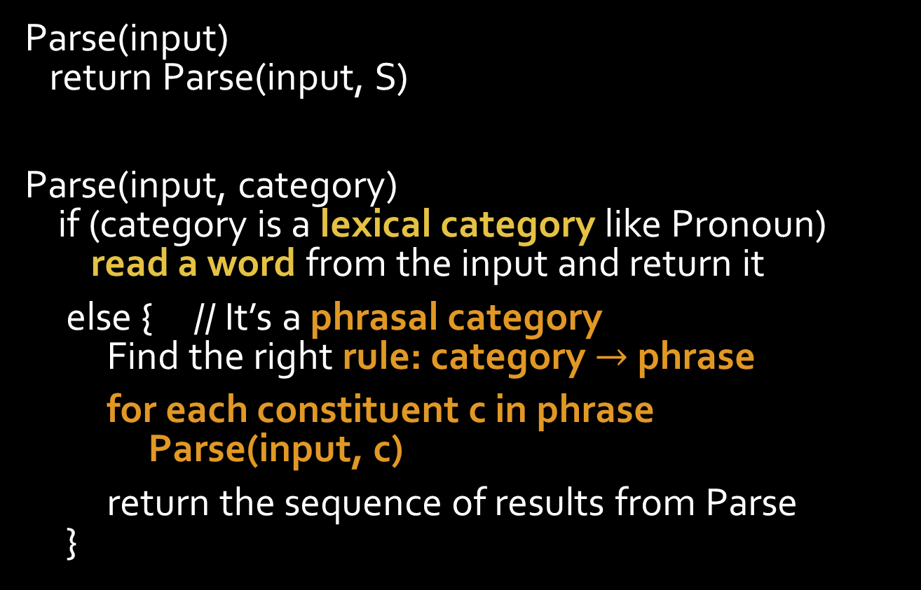
A parsing algorithm
Parse(input) return Parse(input, S)
Parse(input, category) if (category is a lexical category like Pronoun) read a word from the input and return it
else { // It’s a phrasal category Find the right rule: category $→$ phrase
for each constituent c in phrase Parse(input, c)
return the sequence of results from Parse }

Slide 8

Here’s the problem
Parse(input, category) if (category is a lexical category like Pronoun) read a word from the input and return it
else { Find the right rule: category $→$ phrase
for each constituent c in phrase Parse(input, c)
return the sequence of results from Parse }

Slide 9

Parsing would be easy if you always knew which rule to pick
To know which S rule to use, you need to know
What the verb is
How many NPs are there
But you don’t know which word is the verb
Until you’ve finished parsing the NP
$S→NP IV$
$S→NP TV NP$
$S→NP DV NP NP$
$NP→Pronoun$
$NP→Det N$

Slide 10
Parsing would be easy if you always knew which rule to pick
This is a bad example
The grammar is kind of contrived
And you can parse it deterministically if we change the rules around
But the general problem is real
$S→NP IV$
$S→NP TV NP$
$S→NP DV NP NP$
$NP→Pronoun$
$NP→Det N$

Slide 11
Deterministic choices don’t work with delayed feedback
What if you don’t have enough information to make the choice now?
What if you can’t know whether it was the right choice until after you make it?
Then you have to guess
And try again if you guessed wrong

Slide 12
Nondeterministic algorithms allow delayed feedback
Algorithms that involve
Nondeterministic choices
Set of options
Without specifying how to select one
Failure
The algorithm can decide it made a wrong choice and give up
We ignore any executions that involve failure
And only look at the results of the successful execution

Slide 13

Nondeterministic parsing algorithm
Parse(input, category) if (category is a lexical category like Pronoun) { read the next word w if w isn’t in the category fail
} else { // It’s a phrasal category Choose a rule: category $→$ phrase
for each constituent c in phrase Parse(input, c)
return the sequence of results from Parse }

Slide 14






Choices form a tree

Slide 15
Simulating nondeterminism

Slide 16
Faking nondeterminism
That’s all great
But real computers are deterministic
At least mostly
How do we
Transform a nondeterministic algorithm
Into a deterministic one?
Need to decide how to change
Choice points and failures
Into deterministic equivalents

Slide 17
Parallelism
Each time we hit a choice point
Spawn a thread for each possible choice
Each time we hit a failure point
Kill that thread
Run until some thread succeeds
If all threads die, problem is unsolvable
Threads are too expensive for this to really be practical
But there have been people who’ve argued for the use of non-determinism in parallel computing languages

Slide 18
Backtracking
Single, deterministic thread
Choice point picks a first choice to try
Any time we fail
Rewind to the most recent choice (backtrack)
If there are other options we have tried for that choice
Try again with one of them
If not, rewind to choice before that (backtrack again)
And so on
This does a depth-first search of the choice tree

Slide 19
Choice tree for backtracking

Slide 20





















Backtracking is depth-first search

Slide 21
Undoing side effects
One problem with backtracking is that we have to forget everything we did in the failed branches
For example, our parsing algorithm
Has to unread the words it read from the input
There are two basic strategies for this
Never have any side effects to begin with
So it’s like functional programming in 111
Keep an undo stack
List of everything you did so you can undo it later
When you perform a side-effect
Push the information about how to undo it on the undo stack
When you backtrack
Use the information on the stack to set things back the way they were

Slide 22
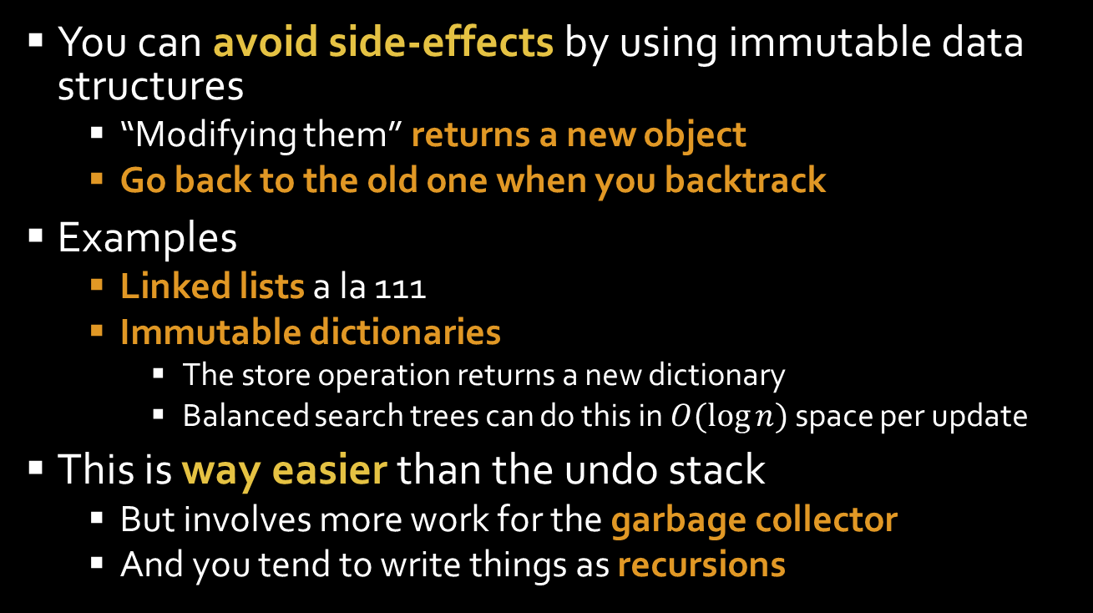
Immutable data (aka functional data structures)
You can avoid side-effects by using immutable data structures
“Modifying them” returns a new object
Go back to the old one when you backtrack
Examples
Linked lists a la 111
Immutable dictionaries
The store operation returns a new dictionary
Balanced search trees can do this in $O(\log{n})$ space per update
This is way easier than the undo stack
But involves more work for the garbage collector
And you tend to write things as recursions

Slide 23
Continuations

Slide 24
How a C program executes (highly simplified)
Make an activation record containing
The arguments
The address to return to in the calling procedure
Push it onto a stack of activation records
Jump to the new procedure
The procedure runs
Pop the activation record
Push return value
Jump back

Slide 25
The execution stack
The stack of activation records is called the execution stack or just the stack
Activation records are often just called stack frames
The top of the stack is always the activation record for the currently executing procedure

Slide 26
What’s a procedure?
The called procedure is
The return address is
A location of some code in memory
That you can jump to
And pass information to (arguments)
A location of some code in memory
That you can jump back to
And pass information to (return value)

Slide 27
The return address is really a procedure argument
Called the continuation of the called procedure
A continuation is a procedure
You call when you’re done
And optionally pass information to
So
Return address is an implicit continuation argument
Passed automatically by the compiler
The return statement in C/C++/C# calls it

Slide 28
Kinds of continuations
Implicit continuation
The return address passed in languages like C
And called by the return statement
Exception continuation
A different location and stack frame you jump to when there’s an exception
Explicit continuation
Any old procedure you pass to a procedure yourself
And that the called procedure treats as a continuation

Slide 29
Explicit continuation passing
void PrintSquare() { var s = Square(7); Console.WriteLine(s); }
int Square(int x) { return x*x; }
void PrintSquare() { Square(7, K); }
void K(int s) { Console.WriteLine(s); }
void Square(int x, Continuation k) { k(x*x); }

Slide 30
Explicit continuation passing
Or using lambda expressions:
void PrintSquare() { Square(7, s => Console.WriteLine(s)); }
void Square(int x, Continuation k) { k(x*x); }

Slide 31
Backtracking in C#

Slide 32
Backtracking uses two continuations
Backtracking effectively has separate continuations for
Success: what to do if this step works
Points to the normal next thing to do
Failure: what to do if it fails
Picks up at the last choice point with a new choice
If it fails, it invokes its own failure continuation

Slide 33
Implementing backtracking
Ensure control transfers to the right point upon success or failure
Success: go forward to the next thing to do
Failure: go back to the last choice

Slide 34
Strategy 1: exceptions
In some ways, the simplest solution is to use the two continuations C# already gives us
Use the normal continuation for success
Use the exception continuation for failure
This turns out to be painfully slow because of the way exception handling gets implemented
Each catch and throw does a call into the OS kernel
But it’s nice and clear, so we’ll talk about it

Slide 35
Code for a choice point
Basic idea
Return upon success
Throw an exception upon failure
Catch exceptions at choice points
Most recent choice point always catches exception
And tries another choice
And throws its own failure if we’re out of options
void Choose() { try { ChoiceA(); return; } catch (Fail e) { }
try { ChoiceB(); return; } catch (Fail e) { }
…
throw new Fail(); }

Slide 36
Code for a choice point
Basic idea
Return upon success
Throw an exception upon failure
Catch exceptions at choice points
Most recent choice point always catches exception
And tries another choice
And throws its own failure if we’re out of options
void Choose() { foreach (var choice in choices) try { choice(); return; } catch (Fail e) { }
throw new Fail(); }

Slide 37
Strategy 2: explicit success continuations
Use the normal continuation for failure
Just return
Use an explicit continuation for success
If that continuation fails, it returns
Allowing you to try another choice!
Of course, you have to return eventually in C#, so we have the normal continuation return a Boolean
If somebody returns true, then the whole program has succeeded and we’re done
If it returns false, we’re backtracking and need to try our next choice

Slide 38
Code for a choice point
We get called with a success continuation k
It may reject the choice we try
By failing (returning false)
So we keep having to try choices until it likes it
We return true if everything worked
We found a good choice and the continuation accepted it
We return false if we fail
bool Choose(Continuation k) { if (Choice1(k)) return true; if (Choice2(k)) return true; …
return false; }
bool Choice1(Continuation k) { if (this seems like a bad choice) return false; return k(1); // choose 1 as our answer }
bool Choice2(Continuation k) { return k(2); // choose 2 as our answer }
… more choices …

Slide 39
Or to be a little more clever
Try each choice, passing it our continuation
If it returns true, we’re done
Otherwise, try another choice
If we run out of choices, return false
bool Choose(Continuation k) { return Choice1(k) || Choice2(k) || more choices … }
bool Choice1(Continuation k) { if (this seems like a bad choice) return false; return k(1); // choose 1 as our answer }
bool Choice2(Continuation k) { return k(2); // choose 2 as our answer }
… more choices …

Slide 40
We can use a loop if there are a lot of choices
Try each choice, passing it our continuation
If it returns true, we’re done
Otherwise, try another choice
If we run out of choices, return false
bool Choose(Continuation k) { foreach (var choice in choices) if (choice(k)) return true; return false; }
Func<Continuation, bool>[] choices = { Choice1, Choice2, …};
bool Choice1(Continuation k) { if (this seems like a bad choice) return false; return k(1); // choose 1 as our answer }
bool Choice2(Continuation k) { return k(2); // choose 2 as our answer }
… more choices …

Slide 41
Implementing sequences
In deterministic code
Each step in a sequence is the continuation for the previous step
A takes B as a continuation
B takes C
And C takes k
The thing to do after the Sequence
Implicit continuations:
void Sequence() { A(); B(); C(); }
Equivalent w/explicit continuations:
void Sequence(Continuation k) {
A(() => B(() =>C(k));
}

Slide 42
Implementing sequences
It’s basically the same for nondeterministic code
Each step’s
Success continuation is the next step
Fail continuation is the previous step
(But we’re implementing fail continuations by returning false)
bool Sequence(Continuation k) { return A(() => B(() => C(k)));
}
bool A(Continuation k) { foreach (var choice in AChoices) if (choice(k)) return true; return false; }
bool B(Continuation k) { foreach (var choice in BChoices) if (choice(k)) return true; return false; }
…

Slide 43
Example

Slide 44
Example: Parsing
We can write a simple parser as a set of non-deterministic procedures
Inputs
A linked list of words
Null means end of input
A continuation
Takes the remaining unparsed words
Returns
True if we’ve successfully parsed the sentence
False if we need to backtrack

Slide 45
Type declaration for Continuations
delegate bool Continuation(WordList w);
This says a Continuation is a procedure that
Input is a WordList
Returns a Boolean
This is the equivalent of the C statement: typedef (*bool(WordList *)) Continuation;

Slide 46
Recognizing a set of words
// Succeeds if the first word in the list is a pronoun // and continuation likes the rest of the words
bool Pronoun(WordList w, Continuation k) {
if (w != null && Pronouns.Contains(w.FirstWord) // It’s a pronoun, so call the success continuation return k(w.Rest);
// Otherwise it’s not, so backtrack return false; }
// List of all the pronouns
string[] Pronouns = { “I”, “you”, … etc … };

Slide 47
Or if you want to be clever
// Succeeds if the first word in the list is a pronoun // and continuation likes the rest of the words
bool Pronoun(WordList w, Continuation k) {
return w != null && Pronouns.Contains(w.FirstWord) && k(w.Rest);
}
// List of all the pronouns
string[] Pronouns = { “I”, “you”, … etc … };

Slide 48
We can do the same for all the other lexical categories
bool Noun(WordList w, Continuation k) { … }
bool ProperNoun(WordList w, Continuation k) { … }
bool Adj(WordList w, Continuation k) { … }
bool Det(WordList w, Continuation k) { … }
bool IV(WordList w, Continuation k) { … }
bool TV(WordList w, Continuation k) { … }
bool DV(WordList w, Continuation k) { … }

Slide 49
A phrasal category
// Succeeds is wordlist starts with an NP // and continuation likes whatever is after the NP
bool NP(WordList w, Continuation k) {
if (Pronoun(w, k)) // starts with a pronoun, so it starts with an NP return true;
// Look to see if it’s Det N if (Det(w, remaining => Noun(remaining, k)) // It’s a Det followed by an Noun and k liked it return true;
return false;
}

Slide 50
Or being clever again
// Succeeds is wordlist starts with an NP // and continuation likes whatever is after the NP
bool NP(WordList w, Continuation k) {
return Pronoun(w, k) || Det(w, remaining => Noun(remaining, k));
}

Slide 51
Parsing a sentence
bool Parse(WordList w) {
// w is a sentence if S can parse it with no words remaining return S(w, r => r == null);
}
bool S(WordList w, Continuation k) {
return NP(w, r => IV(r, k)) || NP(w, r => TV(r, r2 => NP(r2, k)) || NP(w, r => DV(r, r2 => NP(r2, r3 => NP(r3, k));
}

Slide 52
Or to be very cute …
bool Parse(WordList w) => S(w, r => r == null);
bool S(WordList w, Continuation k) => NP(w, r => IV(r, k)) || NP(w, r => TV(r, r2 => NP(r2, k)) || NP(w, r => DV(r, r2 => NP(r2, r3 => NP(r3, k));
bool NP(WordList w, Continuation k)
=> Pronoun(w, k) || Det(w, remaining => Noun(remaining, k));
bool Pronoun(WordList w, Continuation k)
=> w != null && Pronouns.Contains(w.FirstWord) && k(w.Rest);
bool Noun(WordList w, Continuation k) => …
bool ProperNoun(WordList w, Continuation k) => …
…

